Slide 1





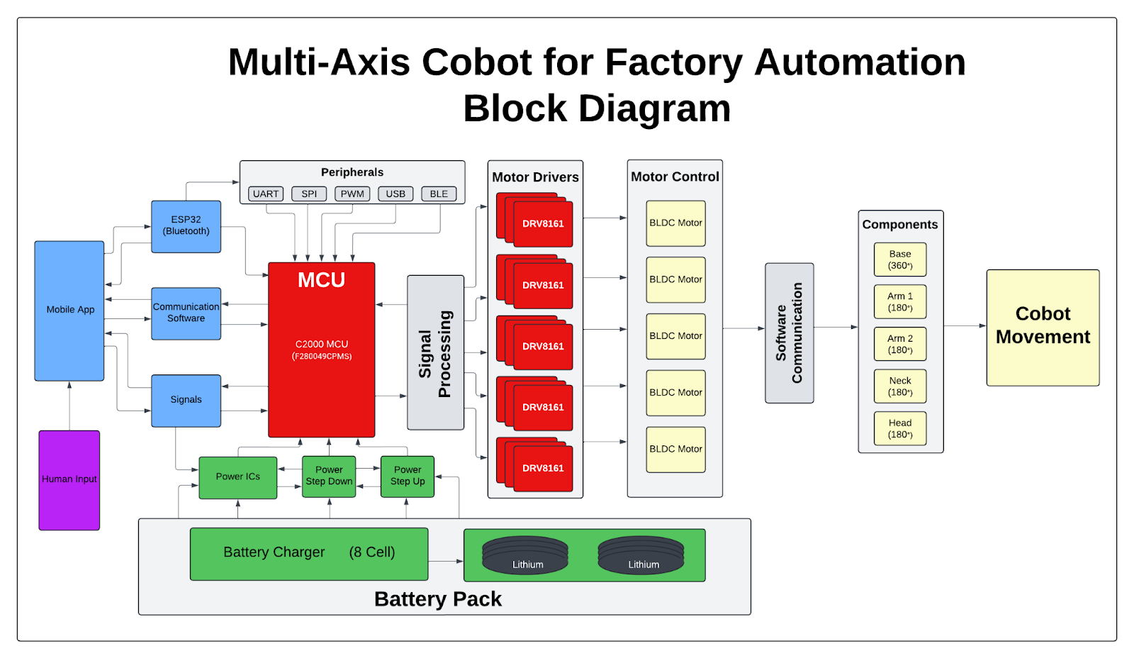
Booth Number: XXX
Will be provided by Showcase Team by April 11, 2025
Multi-Axis Cobot for Factory Automation
Ethan Woods, Adrian Guzman, Emily Hamsa, Jaishil Shah
Dr. Prasad Enjeti
Problem Definition
In factories, there are settings and environments that may be dangerous for employees. Employees may also be tasked with repetitive jobs that lead to burnout or injury. To remedy these issues, we designed a proof-of-concept wirelessly controlled, battery powered multi-axis cobot that will be able to take the place of these employees and improve working conditions.
Engineering Analysis
Mauris orci mi, varius id diam id, egestas auctor enim. Praesent ut massa nibh. Duis purus neque, facilisis cursus ultrices vel, ullamcorper ac augue [See Figure A]. Done:
Sed in risus nibh. In nisl quam, aliquet sed nibh sitamet, faucibus placerat dui.
Fusce quis augue scelerisque, luctus rum sed, ut dolor. pulvinar urna in eros posuere.
in elementum orci dignissim. Proin semper
Table 1. Caption in, 28 points, italicized.
Chart Title
8.01 | 7.99 | 5.77 | 6.44
4.50 | 3.11 | 9.55 | 1.12
6.15 | 8.00 | 6.18 | 5.65
8.21 | 2.16 | 3.11* | 7.17
3.00 | 9.70 | 10.50 | 4.45
Mauris orci mi, varius id diam id, egestas auctor enim. Praesent ut massa nibh. Duis purus neque, facilisis cursus ultrices vel, ullamcorper ac augue. Donec semper lorem vitae urna pulvinar,.
Methodology
The project was broken down into four different subsystems, Motor Driver, MCU/Processing, Power, and Wireless Application. In doing so, we are able to create our individual systems and integrate once operational.
Hardware Implementation:
Motor Driver: MCU/Processing:
Power:
Mobile Application:
Control Logic & Signal Flow:
Outcomes
Mauris orci mi, varius id diam id, egestas auctor enim. Praesent ut massa nibh. Duis purus neque, facilisis cursus ultrices vel, ullamcorper ac augue. Donec semper lorem vitae urna pulvinar,.
Sed in risus nibh. In nisl quam, aliquet sed nibh sit amet, faucibus placerat dui. Fusce quis augue scelerisque, luctus rum sed, porta ut dolor. In
Impact
Mauris orci mi, varius id diam id, egestas auctor enim. Praesent ut massa nibh. Duis purus neque, facilisis cursus ultrices vel, ullamcorper ac augue. Donec semper lorem:
Sed Risus Nibh: CiIn nisl quam, aliquet sed nibh sitamet, faucibus placerat dui augue scelerisque.
Curabitur Accumsan Nulla: Fusce quis augue urna scelerisque, luctus rum sed, ut dolor in pulvinar in eros.
Elementum Orci Dignissim: Proin semper ipsum finibus quam tempor, vitae.
neque dignissim, and in aliquet nisl et umis.
Figure 2. Caption in, 28 points, italicized.
Series 1
Series 2
Series: in et neque dignissim, and in aliquet nisl et umis.
Series 3
Figure 3. Caption in, 28 points, italicized.
Table 1. Caption in, 28 points, italicized.
Figure 4. Caption in, 28 points, italicized.
Chart Title
8.01 | 7.99 | 5.77 | 6.44
4.50 | 3.11 | 9.55 | 1.12
6.15 | 8.00 | 6.18 | 5.65
8.21 | 2.16 | 3.11* | 7.17
3.00 | 9.70 | 10.50 | 4.45
MAURIS ORCI MI VARIUS ID DIAM Egestas auctor enim. Praesent ut massa nibh. Duis purus neque, facilisis cursus ultrices vel, ullamcorper ac augue. Donec semper lorem. Mauris orci mi, varius id diam id, egestas auctor enim. Praesent ut massa nibh. Duis purus neque, facilisis tristique quis augue scelerisque.
References
Phasellus nec lectus bibendum, posuere nibh id, lacinia
Mauris orci mi, varius id diam id, egestas auctor enim
Duis vitae tincidunt tortor, vitae sollicitudin magna
Aenean et est sem. Phasellus nec lectus bibendum
Lacinia magna. Mauris orci mi, varius id diam id, egestas
Mauris orci mi, varius id diam id, egestas auctor enim
Duis vitae tincidunt tortor, vitae sollicitudin magna
Figure 1. System Block Diagram
*Unamcorper efficitur sed in nulla.
Acknowledgements
Acknowledgments in Arial, 24 points, try to keep to one or two lines,

